Slide 1
Artificial Intelligence for Games Week 2 – AI Architecture 2 + Project 1 Steve Rabin
For help on projects, email everyone (select and copy this string from the start of any class PowerPoint):
steve.rabin@gmail.com, p.jiankai@digipen.edu, b.hsu@digipen.edu, zak.s@digipen.edu, keaton.sullivan@digipen.edu, john.tseng@digipen.edu, a.roulst@digipen.edu
TAs: Jian Kai Phua, Brandon Hsu, Zak Stephenson, Keaton Sullivan, John Tseng, Andrew Roulst

Slide 2
Questions
Describe an Option
Describe a Reasoner
What are the Reasoners in:
FSM
Behavior Tree
Rule-Based
Utility
Planning

Slide 3
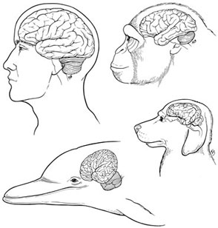
Common AI Architectures

Slide 4
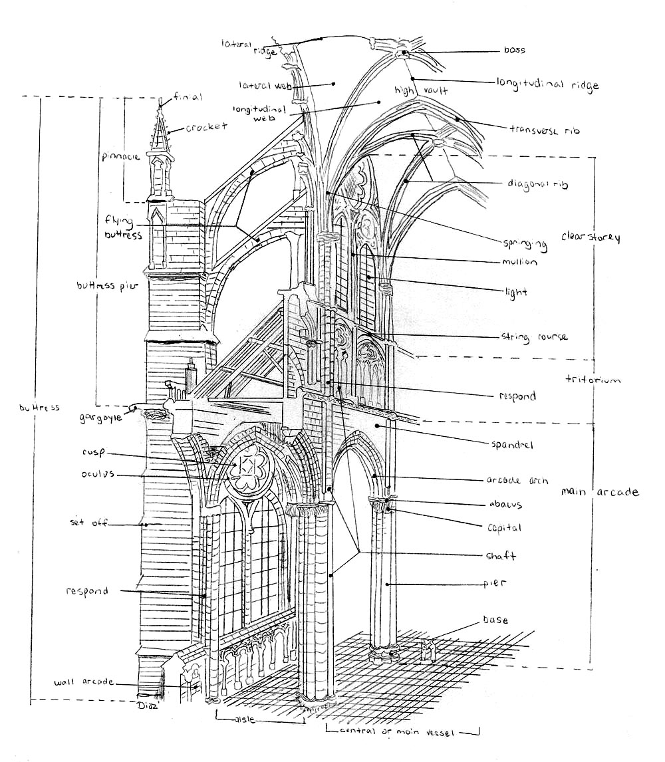
Common AI Architectures
Scripting
Finite-State Machine
Behavior Tree
Rule-Based
Utility-Based
Planning

Slide 5

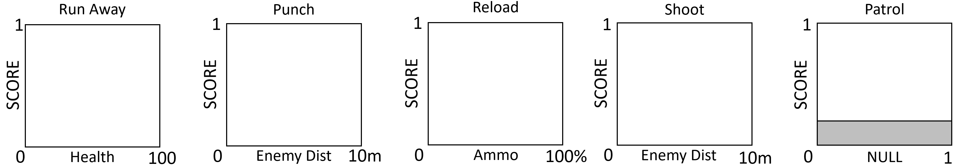
Draw a Utility Curve
Draw the Utility curves (all except for Patrol) for an NPC with the following requirements:
NPC that would like to Reload below 50% ammo. Always prefer Reload instead of Shoot at less than 25% ammo.
NPC that prefers Reload instead of Shoot if ammo 25% to 50% and enemy is more than 5m away.
NPC wants to Shoot enemies up to 9m away.
NPC will Punch enemies up to 1m away (always preferable to Shoot or Reload).
If NPC has less than 10 health, NPC must always Run Away.
Patrol if nothing else is desired.

Slide 6
Draw a Utility Curve
Draw the Utility curves (all except for Patrol) for an NPC with the following requirements:
NPC that would like to Reload below 50% ammo. Always prefer Reload instead of Shoot at less than 25% ammo.
NPC that prefers Reload instead of Shoot if ammo 25% to 50% and enemy is more than 5m away.
NPC wants to Shoot enemies up to 9m away.
NPC will Punch enemies up to 1m away (always preferable to Shoot or Reload).
If NPC has less than 10 health, NPC must always Run Away.
Patrol if nothing else is desired.

Slide 7
Draw a Utility Curve
Draw the Utility curves (all except for Patrol) for an NPC with the following requirements:
NPC that would like to Reload below 50% ammo. Always prefer Reload instead of Shoot at less than 25% ammo.
NPC that prefers Reload instead of Shoot if ammo 25% to 50% and enemy is more than 5m away.
NPC wants to Shoot enemies up to 9m away.
NPC will Punch enemies up to 1m away (always preferable to Shoot or Reload).
If NPC has less than 10 health, NPC must always Run Away.
Patrol if nothing else is desired.

Slide 8
Draw a Utility Curve
Draw the Utility curves (all except for Patrol) for an NPC with the following requirements:
NPC that would like to Reload below 50% ammo. Always prefer Reload instead of Shoot at less than 25% ammo.
NPC that prefers Reload instead of Shoot if ammo 25% to 50% and enemy is more than 5m away.
NPC wants to Shoot enemies up to 9m away.
NPC will Punch enemies up to 1m away (always preferable to Shoot or Reload).
If NPC has less than 10 health, NPC must always Run Away.
Patrol if nothing else is desired.

Slide 9
Draw a Utility Curve
Draw the Utility curves (all except for Patrol) for an NPC with the following requirements:
NPC that would like to Reload below 50% ammo. Always prefer Reload instead of Shoot at less than 25% ammo.
NPC that prefers Reload instead of Shoot if ammo 25% to 50% and enemy is more than 5m away.
NPC wants to Shoot enemies up to 9m away.
NPC will Punch enemies up to 1m away (always preferable to Shoot or Reload).
If NPC has less than 10 health, NPC must always Run Away.
Patrol if nothing else is desired.

Slide 10
Draw a Utility Curve
Draw the Utility curves (all except for Patrol) for an NPC with the following requirements:
NPC that would like to Reload below 50% ammo. Always prefer Reload instead of Shoot at less than 25% ammo.
NPC that prefers Reload instead of Shoot if ammo 25% to 50% and enemy is more than 5m away.
NPC wants to Shoot enemies up to 9m away.
NPC will Punch enemies up to 1m away (always preferable to Shoot or Reload).
If NPC has less than 10 health, NPC must always Run Away.
Patrol if nothing else is desired.

Slide 11
Draw a Utility Curve
Draw the Utility curves (all except for Patrol) for an NPC with the following requirements:
NPC that would like to Reload below 50% ammo. Always prefer Reload instead of Shoot at less than 25% ammo.
NPC that prefers Reload instead of Shoot if ammo 25% to 50% and enemy is more than 5m away.
NPC wants to Shoot enemies up to 9m away.
NPC will Punch enemies up to 1m away (always preferable to Shoot or Reload).
If NPC has less than 10 health, NPC must always Run Away.
Patrol if nothing else is desired.

Slide 12
Draw a Utility Curve
Draw the Utility curves (all except for Patrol) for an NPC with the following requirements:
NPC that would like to Reload below 50% ammo. Always prefer Reload instead of Shoot at less than 25% ammo.
NPC that prefers Reload instead of Shoot if ammo 25% to 50% and enemy is more than 5m away.
NPC wants to Shoot enemies up to 9m away.
NPC will Punch enemies up to 1m away (always preferable to Shoot or Reload).
If NPC has less than 10 health, NPC must always Run Away.
Patrol if nothing else is desired.

Slide 13
Draw a Utility Curve
Draw the Utility curves (all except for Patrol) for an NPC with the following requirements:
NPC that would like to Reload below 50% ammo. Always prefer Reload instead of Shoot at less than 25% ammo.
NPC that prefers Reload instead of Shoot if ammo 25% to 50% and enemy is more than 5m away.
NPC wants to Shoot enemies up to 9m away.
NPC will Punch enemies up to 1m away (always preferable to Shoot or Reload).
If NPC has less than 10 health, NPC must always Run Away.
Patrol if nothing else is desired.

Slide 14
Draw a Utility Curve
Draw the Utility curves (all except for Patrol) for an NPC with the following requirements:
NPC that would like to Reload below 50% ammo. Always prefer Reload instead of Shoot at less than 25% ammo.
NPC that prefers Reload instead of Shoot if ammo 25% to 50% and enemy is more than 5m away.
NPC wants to Shoot enemies up to 9m away.
NPC will Punch enemies up to 1m away (always preferable to Shoot or Reload).
If NPC has less than 10 health, NPC must always Run Away.
Patrol if nothing else is desired.

Slide 15
Draw a Utility Curve
Draw the Utility curves (all except for Patrol) for an NPC with the following requirements:
NPC that would like to Reload below 50% ammo. Always prefer Reload instead of Shoot at less than 25% ammo.
NPC that prefers Reload instead of Shoot if ammo 25% to 50% and enemy is more than 5m away.
NPC wants to Shoot enemies up to 9m away.
NPC will Punch enemies up to 1m away (always preferable to Shoot or Reload).
If NPC has less than 10 health, NPC must always Run Away.
Patrol if nothing else is desired.

Slide 16

Architecture Power Design Patterns
Modularity
Option Stacks
Hierarchical Reasoning
Knowledge Management
Blackboard Architecture
Intelligent Everything

Slide 17
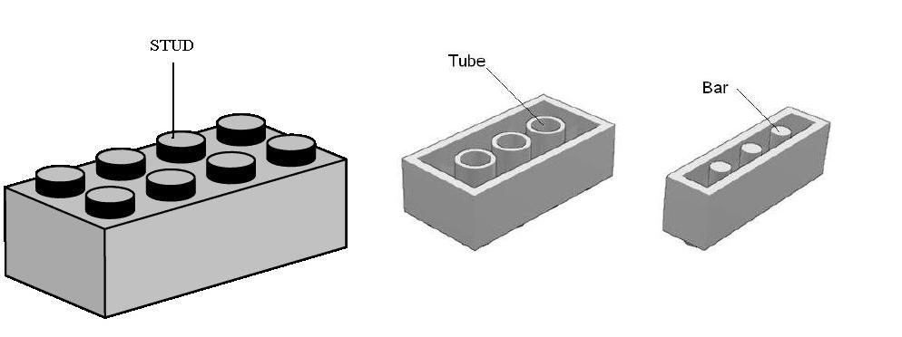
Modularity
Traditional software design pattern
Small reusable chunks with a consistent interface
Component architectures
Consider making a target into a modular object
Options frequently need a target

Slide 18

Modularity Action option needs a target
Target could be a character, position, or the camera
Target could be the output of a reasoner
Select the closest enemy
Modular target decouples specifying and updating target from actions that use it
A distance consideration can compare two targets without caring what types they are
Targets could be stored in a blackboard

Slide 19

Option Stacks
AI can be interrupted by high priority options
Returns to interrupted option when done
New option is placed on stack and executed
When done, option is popped, old option resumes

Slide 20
Option Stacks
Example
Patrolling perimeter
Sees enemy and attacks
After enemy dead, return to patrol
Also known as a
State stack, or Goal stack,
Alternative architecture: Subsumption

Slide 21
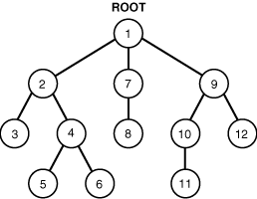
Hierarchical
Scalability is a huge problem
Hierarchical reasoning is the fix

Slide 22
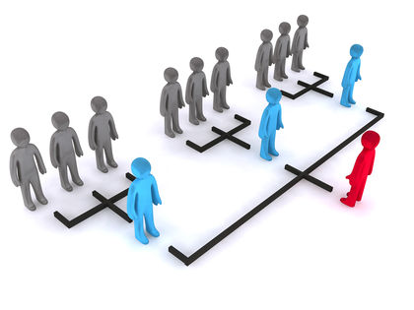
Hierarchical
FSMs become HFSMs
HTN for planners
Behavior Trees
Strategy game AI
General, Platoon, Squad, Soldier
Hierarchical Pathfinding

Slide 23
Knowledge Management
Blackboards
Knowledge Everywhere

Slide 24

Knowledge Management: Blackboards
Store data in communal places
Store data in the terrain or shared data structures
Store expensive checks (LOS or pathing)
Coordinate AI characters

Slide 25

Knowledge Management: Intelligent Everything
Store intelligence in objects and the world
Popularized by The Sims
Smart objects
Smart terrain

Slide 26
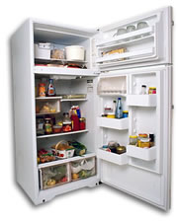
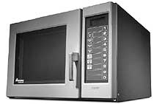

Smart Terrain / Objects
Characters have needs and motivations
Objects satisfy those needs

Slide 27

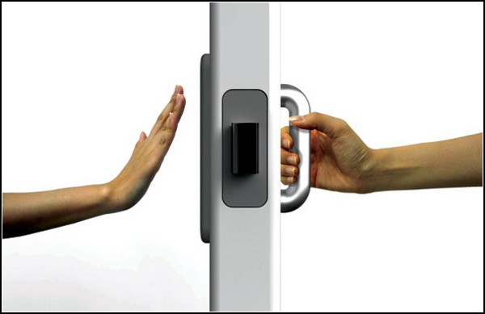
Smart Terrain / Objects
Object instructs agent on use
What does the object offer (broadcasts it)
How to use the object (instructions, animations)
Similar to an affordance
Design of Everyday Things

Slide 28
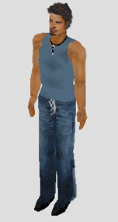
Person
Data
- Needs
- Personality
- Skills
- Relationships
Motive Engine
Skills
- Cooking
- Mechanical
- Logic
- Body
- Etc
Personality
- Sloppy to Neat
- Shy to Outgoing
- Serious to Playful
- Lazy to Active
- Mean to Nice
Physical
- Hunger
- Comfort
- Hygiene
- Bladder
Mental
- Energy
- Fun
- Social
- Room

Slide 29

Person
Stats
-20 Hunger
-12 Comfort
-30 Hygiene
-75 Bladder
+80 Energy
+40 Fun
+10 Social
-60 Room
Mood +18
Toilet
Mood+26
Urinate (+40 Bladder)
Clean (+30 Room)
Unclog (+40 Room)
Bathtub
Mood +20
Take Bath (+40 Hygiene, +30 Comfort)
Clean (+20 Room)

Slide 30
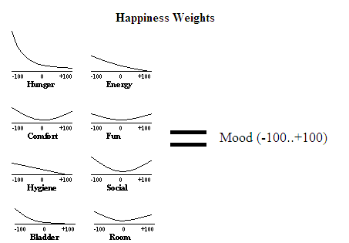
Happiness Weights

Slide 31
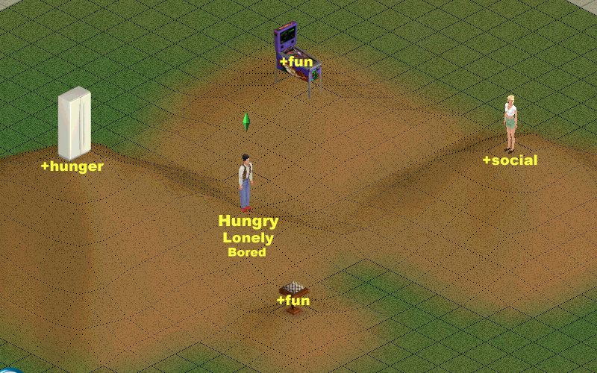
“Happyscape”

Slide 32
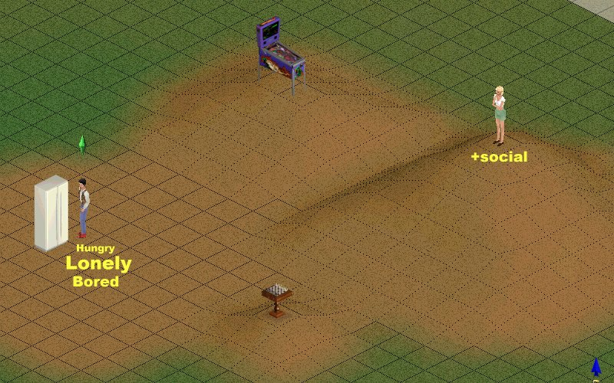
“Happyscape”

Slide 33
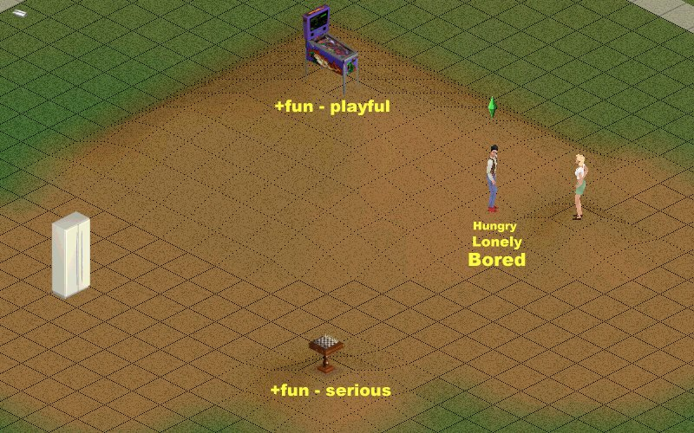
“Happyscape”

Slide 34

The AI Architecture design patterns
Modularity
Option Stacks
Hierarchical
Knowledge Management
Blackboards
Intelligent Everything

Slide 35
Project 1 Examples

Slide 36
Project 1
Assigned week 3 Mon, due week 6 Mon
Download starting code from:
https://github.com/CS380-GameAI/Rabin-Engine
No sharing code on this assignment
You may help each other out with understanding or manipulating the base code, but no collaboration

Slide 37
Project 1
(REQUIRED) Have at least 4 NPCs doing something interesting
(50%) Implement 10 behavior tree nodes
(40%) Using the GUI, create 4 unique behavior trees
(10%) Project post-mortem in readme_project1.txt

Slide 38
Project 1: Details
(50%) Implement 10 behavior tree nodes
At least 3 have to be control flow nodes or decorator nodes
Debugging nodes do not count towards this total
List all nodes you create in readme_project1.txt to receive a grade

Slide 39
Project 1: Details
(40%) Using the GUI, create 4 unique behavior trees
List the names of 4 trees in readme_project1.txt to receive grade
At least 8 nodes in each tree
At least 3 nodes deep at some point in the tree
Root is depth 0, you need at least 3 more levels deep
Must use all 10 of the nodes you created
You don’t need to have all 10 new nodes in any single tree. But every new node must be used in at least one of your created trees.
Must use all 4 trees in the project

Slide 40
Project 1: Details
(10%) Project post-mortem in readme_project1.txt
Answer all questions
One paragraph on what you liked
One paragraph on what you disliked
Mention any difficulties you encountered

Slide 41
Project 1: Details
Turn-in Directions (-10% for incorrect turn-in)
Please see the turn-in directions in the zip file

Slide 42
Project 1: Extra Credit
(5% each)
First to find a particular significant bug in the Behavior Tree framework
Email instructor – no more than 20% per student
(10%) Implement Formations
At least 2 different formations – list in readme_project1.txt to receive grade
Must move various directions as a formation and not single-file queueing
Must use template concept or offset from leader
(10%) Implement Flocking
At least 25 agents
Must implement Separation, Alignment, Cohesion, Wandering

Slide 43
Example of building a tree
Selector
Not Hungry?
Eat Pizza

Slide 44
Example of building a tree
Sequencer
Not Hungry?
Eat Pizza
Selector
Workout

Slide 45
Example of building a tree
Sequencer
Hungry?
Eat Pizza
Selector
Workout
Inverter

Slide 46
Example of building a tree
Sequencer
Hungry?
Sequencer
Selector
Workout
Inverter
Have Pizza?
Eat Pizza

Slide 47
Example of building a tree
Sequencer
Hungry?
Sequencer
Selector
Workout
Inverter
Have Pizza?
Eat Pizza
Eat Pizza
Sequencer
Call Delivery

Slide 48
Three Types of Nodes
Control flow nodes: Run some/all children until conditions are met
C_Sequencer, C_Selector, C_RandomSelector, C_ParallelSequencer
Decorator nodes: Manipulate the status of its only child
D_Delay, D_InvertedRepeater, D_RepeatFourTimes
Leaf nodes: Do condition check or action
L_Idle, L_CheckMouseClick, L_MoveToMouseClick, L_MoveToFurthestAgent, L_MoveToRandomPosition, L_PlaySound

Slide 49
Node Status and Results
Node Result:
In Progress: Node is currently running
Success: Node finishes operation successfully
Failure: Node fails to finish operation
Node Status:
Ready: Node is ready to run
Running: Node is currently running
Exiting: Node has succeeded or failed
Suspended: Node won’t execute anything

Slide 50
Selector Code
if (currentNode->succeeded() == true)
{
on_success();
}
else if (currentNode->failed() == true)
{
// move to the next node
++currentIndex;
// if we hit size, that means all nodes failed
if (currentIndex == children.size())
{
on_failure();
}
}
}
C_Selector::C_Selector() : currentIndex(0) {}
void C_Selector::on_enter()
{
currentIndex = 0;
BehaviorNode::on_enter();
}
void C_Selector::on_update(float dt)
{
// if any child succeeds, node succeeds
// if all children fail, node fails
BehaviorNode *currentNode =
children[currentIndex];
currentNode->tick(dt);

Slide 51
Sequencer Code
if (currentNode->failed() == true)
{
on_failure();
}
else if (currentNode->succeeded() == true)
{
// move to the next node
++currentIndex;
// if we hit the size, then all nodes suceeded
if (currentIndex == children.size())
{
on_success();
}
}
}
C_Sequencer::C_Sequencer() : currentIndex(0) {}
void C_Sequencer::on_enter()
{
currentIndex = 0;
BehaviorNode::on_enter();
}
void C_Sequencer::on_update(float dt)
{
// if any child fails, the node fails
// if all children succeed, the node succeeds
BehaviorNode *currentNode =
children[currentIndex];
currentNode->tick(dt);

Slide 52
Decorator Code – InvertedRepeater
void D_InvertedRepeater::on_update(float dt)
{
BehaviorNode *child = children.front();
child->tick(dt);
if (child->succeeded() == true)
{
on_failure();
}
else if (child->failed() == true)
{
on_success();
}
}
void D_InvertedRepeater::on_exit()
{
// we want the node and child to repeat,
// so go back to ready
set_status(NodeStatus::READY);
}

Slide 53
Decorator Code – Repeat Four Times
if (child->succeeded() == true)
{
++counter;
if (counter == 4) {
on_success();
}
else {
child->set_status(NodeStatus::READY);
}
}
else if (child->failed() == true)
{
on_failure();
}
}
D_RepeatFourTimes::D_RepeatFourTimes() : counter(0) {}
void D_RepeatFourTimes::on_enter()
{
counter = 0;
BehaviorNode::on_enter();
}
void D_RepeatFourTimes::on_update(float dt)
{
// repeat the child until 4 successes,
// stop on any failure
BehaviorNode *child = children.front();
child->tick(dt);

Slide 54
Naïve Architecture
Behavior Trees
Agent Data
Agent1
Agent2
Agent3
Agent4
Tree1
Tree2
Tree3
Tree4
Local Blackboard
Local Blackboard
Local Blackboard
Local Blackboard

Slide 55
Efficient Architecture
Behavior Trees
Tree Layout
Tree1
Tree2
Tree3
Tree4
Agent Data
Agent1
Agent2
Agent3
Tree Data1
Tree Data2
Tree Data1
Local Blackboard
Local Blackboard
Local Blackboard

Slide 56
Project 1: Step-by-Step
Code to edit is in Student/Project_1
Create node classes (look at examples)
Add new nodes to: Nodes.def
Use BehaviorTreeEditor.exe to build trees
Add new trees to Trees.def and NodeHeaders.h
Register agents and assign tree to each agent in Setup.cpp

Slide 57
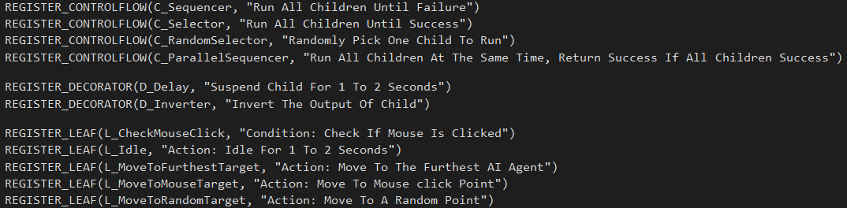
Project 1: Step-by-Step
Edit Student/Project_1/Nodes.def (with the following macros)
REGISTER_CONTROLFLOW(control flow class name, class summary)
REGISTER_DECORATOR(decorator class name, class summary)
REGISTER_LEAF(leaf class name, class summary)

Slide 58
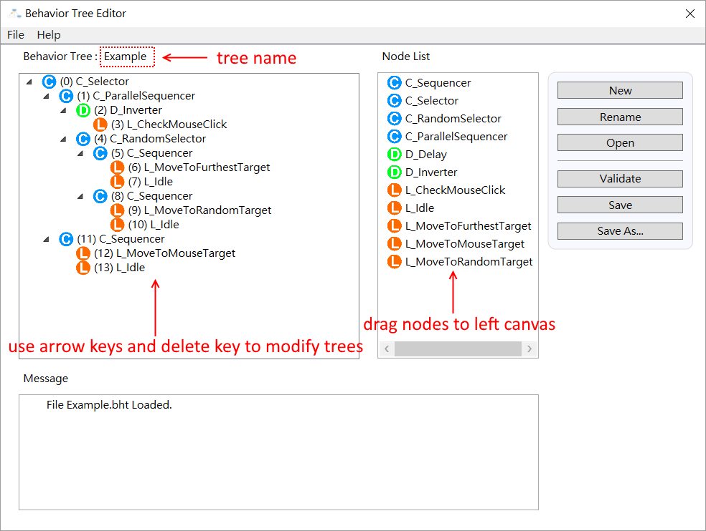
Project 1: Step-by-Step
Use BehaviorTreeEditor.exe to build trees
Parallel Sequencer
Inverter
Check Mouse Click
Random Selector
Sequencer
Move To Furthest
Selector
Idle
Sequencer
Move To Random
Idle
Sequencer
Move To Mouse Target
Idle

Slide 59
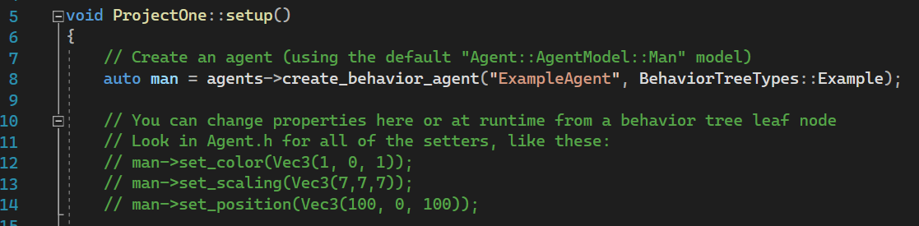
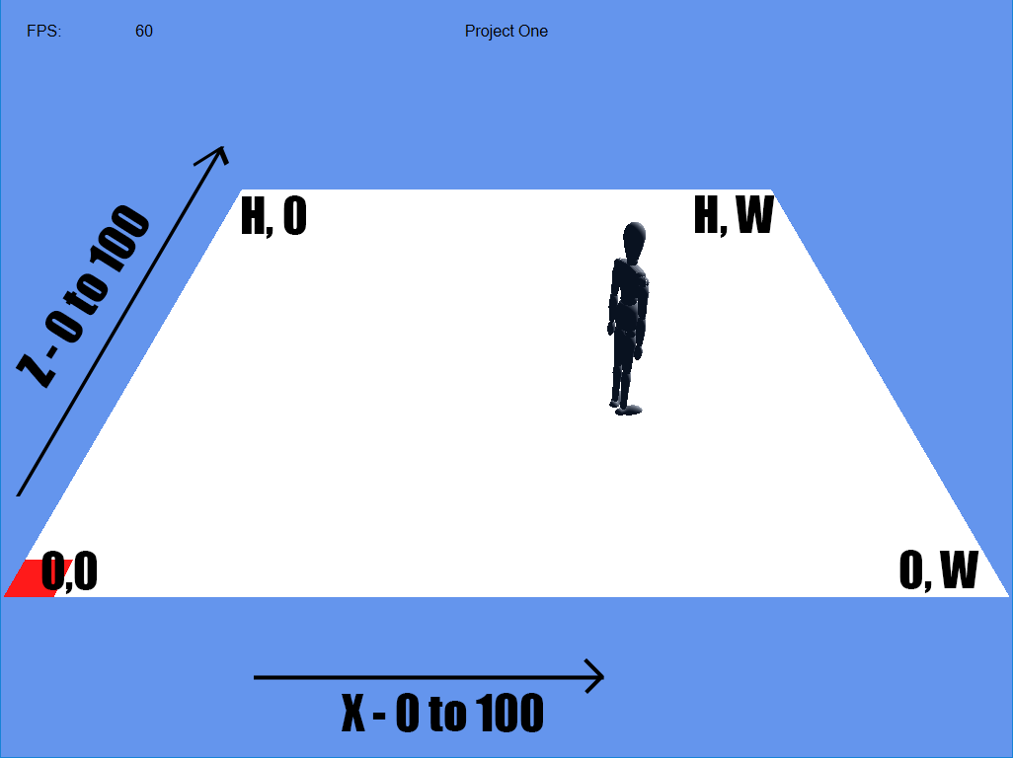
Project 1: Step-by-Step
Register agents and assign tree to each agent in Student/Project_1/Setup.cpp

Slide 60
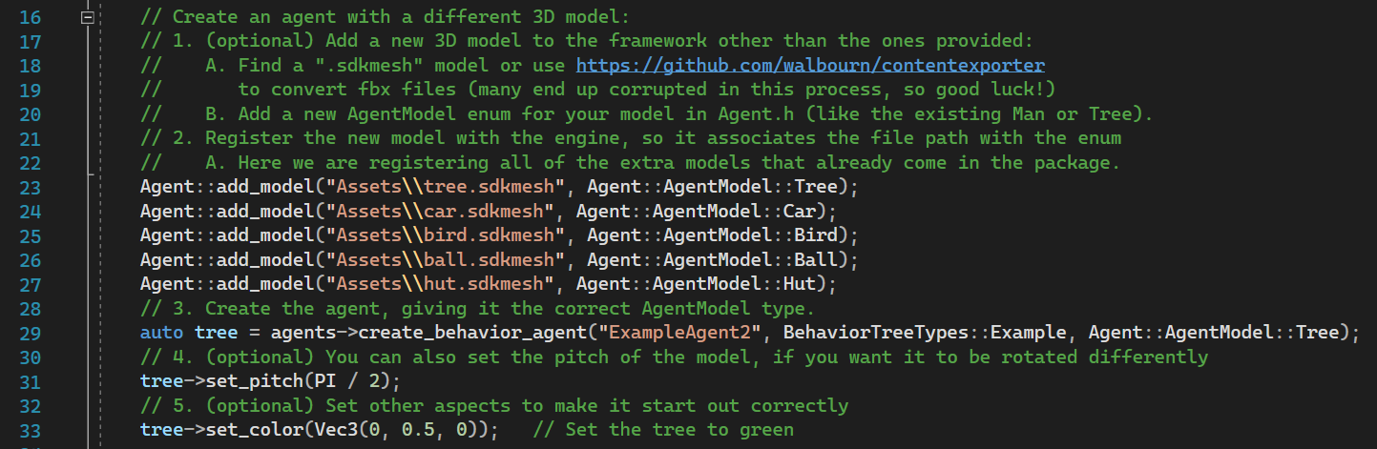
Project 1: Step-by-Step

Slide 61
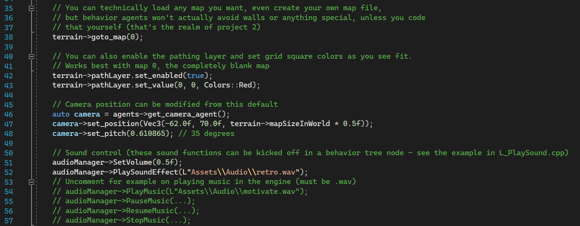
Project 1: Step-by-Step

Slide 62
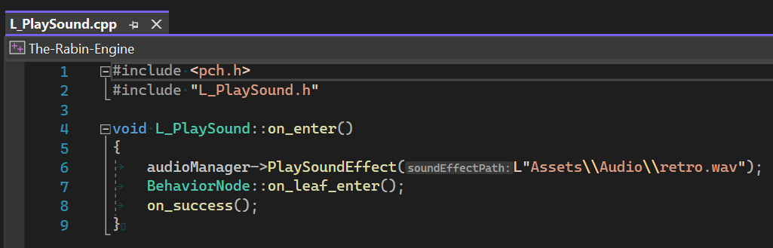
Project 1: Step-by-Step
What about:
Sound
Terrain
Button / Slider Controls
You’re on your own – you can add anything to the base code

